Slide 1
Introduction to Semiconductor Theory

Slide 2
Introduction to Semiconductor Theory
Semiconductor Materials
Semiconductors, as the name implies, are a group of materials whose electrical conductivity is greater than that of insulators but less than that of metals.
Insulators Semiconductors
Metals
Increasing conductance
Semiconductor materials are found in Group IV and neighbouring columns of the periodic table. The ones in group IV (C, Si, Ge) are called elemental semiconductors because they are composed of the pure element.
II | III | IV | V | VI
 | B Al | C Si | N P | S
Zn | Ga | Ge | As | Se
Cd | In |  | Sb | Te

Slide 3
Introduction to Semiconductor Theory
Elemental | IV compunds | Binary III-V compounds | Binary II-VI compunds | Ternary compounds | Quaternary compounds
Si Ge | SiC SiGe | AlP AlAs | ZnS ZnSe | GaAsP AlGaAs | InGaAsP
 |  | AlSb | ZnTe
 |  | GaN | CdS
 |  | GaP | CdSe
 |  | GaAs | CdTe
 |  | GaSb
 |  | InP
 |  | InAs
 |  | InSb
These compounds are widely used in various electronic and optical applications.

Slide 4
Why semiconductor device ?
Semiconductor devices such as diodes, transistors and integrated circuits can be found everywhere in our daily lives like in televisions, automobiles, washing machines and computers.
Semiconductor conductivity can be varied/controlled.
Semiconductor is easily available.

Slide 5
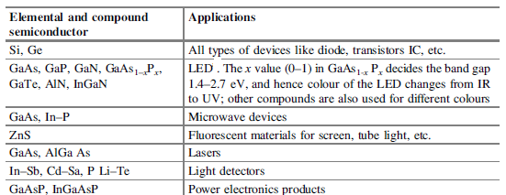
Application of semiconductor

Slide 6
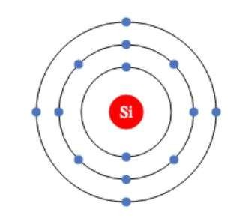
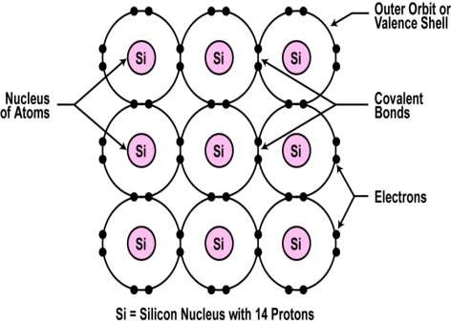
Semiconductor
Silicon : It’s a Group 4 element which means it has 4 electrons in outer
shell.
However, like all other elements it would prefer to have 8 electrons in its
outer shell.
The unique capability of semiconductor atoms is their ability to link together
to form a physical structure called a crystal lattice.
The binding forces between neighboring atoms results from the fact that each of the valance electrons is shared by one of its four nearest neighbors.
These links are called covalent bonds.

Slide 7
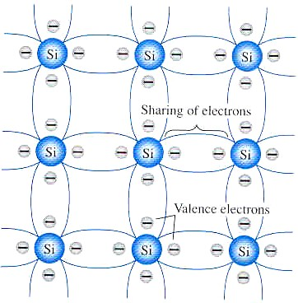
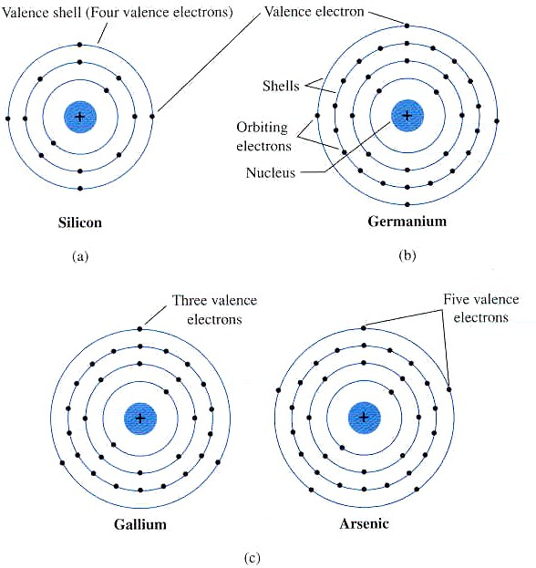
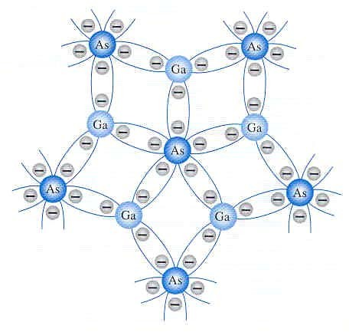
Introduction to Semiconductor Theory
Covalent Bond Structure of Semiconductors

Slide 8
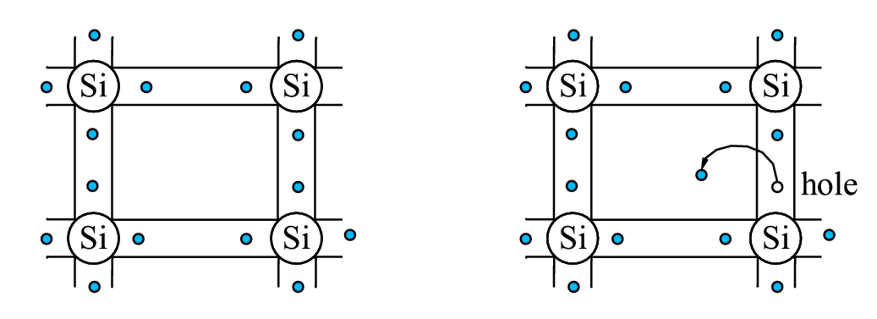
Intrinsic Material
A pure semiconductor crystal with no impurities or lattice defects is called an
intrinsic semiconductor.
At T=0 K
Valence band is full with electrons
Conduction band is empty
So no carriers available for
conduction.
At T>0 thermal fluctuations break electrons to free creating electron-hole pairs.
Electron-hole pairs (EHP) are generated.
Number of electrons=No. of holes

Slide 9
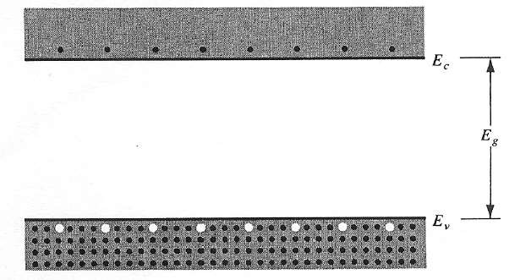
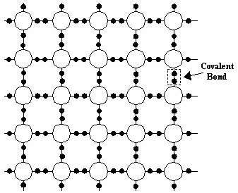
electrons and holes
Electron-hole pairs in a semiconductor. The bottom of the conduction band denotes as E_{c} and the top of the valence band denotes as E_{v}.
For T>0
some electrons in the valence band receive enough thermal energy to be excited across the band gap to the conduction band.
The result is a material with some electrons in an empty conduction band and some unoccupied states in an filled valence band.
An empty state in the valence band is referred to as a hole.
If the conduction band electron and the hole are created by the excitation of a valence band electron to the conduction band, they are called an electron-hole pair (EHP).

Slide 10
  At 0 Kelvin there are no free charge carriers, but as temp increases a few electron- hole pairs (EHP) are generated due to valence electrons getting thermally excited to have enough energy to “jump” over the bandgap into the conduction band.
Since electron-holes are always created in pairs, then
n = p = n_{i}
where n and p are the electrons and holes concentration (per cm³), respectively
  Recombination occurs when an electron in the conduction band makes a transition to the valence band to recreate a complete covalent bond structure with the hole
  At steady state, EHPs recombine at the same rate as they are generated
  Generation and recombination of EHP are dependent on temperature

Slide 11
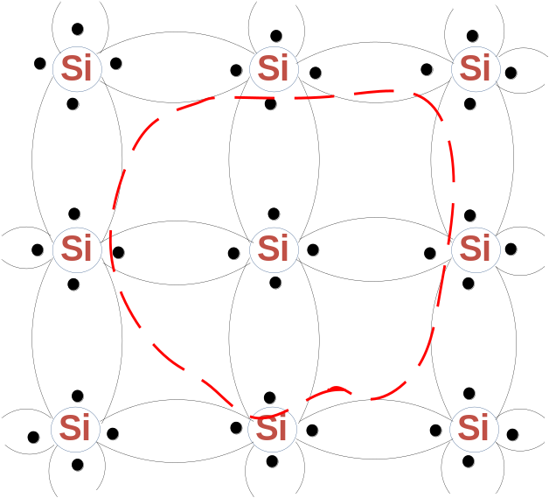
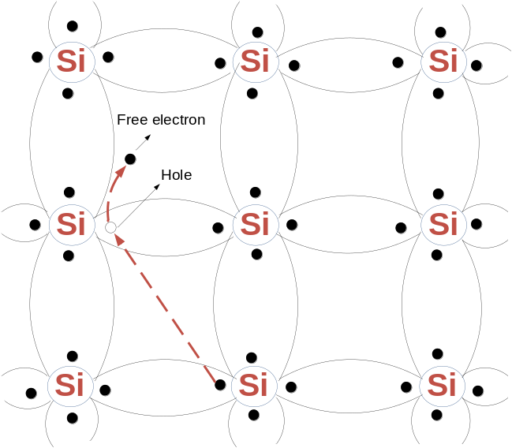
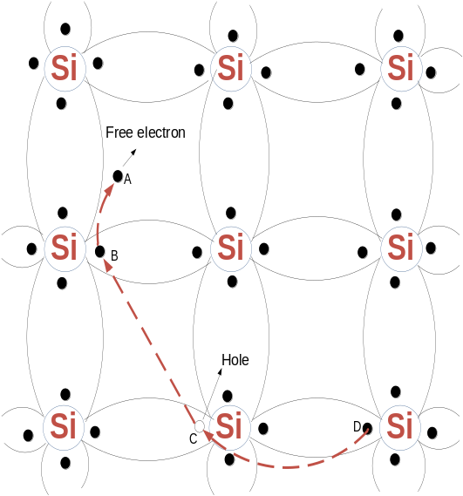
Structure of Si Semiconductor

Slide 12
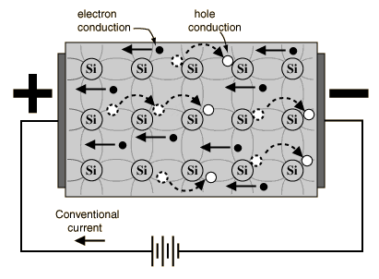
current carrying mechanisim of hole
If a voltage is applied, then both the electron and the hole
can contribute to a small current flow.
Current carried by valence electrons in valance band is called as hole
current.
Current carried by free electrons in conuction band is called as electron
current.

Slide 13
How to Increase conductivity
Case-1
The conductivity of the semiconductor material increases when the
temperature increases.
This is because the application of heat makes it possible for some
electrons in the valence band to move to the conduction band.
Obviously the more heat applied the higher the number of electrons that can gain the required energy to make the conduction band transition and become available as charge carriers.
This is how temperature affects the carrier concentration.
Case-2
Another way to increase the number of charge carriers is to add them in
from an external source.
Doping or implant is the term given to a process whereby one element is
injected with atoms of another element in order to change its properties.
Semiconductors (Si or Ge) are typically doped with elements such as Boron, Arsenic and Phosphorous to change and enhance their electrical properties.

Slide 14
Extrinsic semiconductor
Doping is the process of adding specific impurities to a pure semiconductor in such a way that the newly formed covalent bonding creates excess charge carriers within the crystal lattice
When a crystal is doped such that the equilibrium carrier concentrations n₀ and p_{o} are different from the intrinsic carrier concentration n_{i}, the material is said to be extrinsic.
When trivalent impurities( B, Al) are added to intrinsic semiconductor, then it is called as p-type extrinsic semiconductor.
When pentavalent impurities(P,As) are added to intrinsic semiconductor,
then it is called as n-type extrinsic semiconductor.
When impurities or lattice defects are introduced, additional levels are
created in the energy bands structure, usually within the band gap.

Slide 15
N-Type Semiconductor:
The N-type of material is obtained by adding the impurity of five valance electrons(penta-valent) such as antimony, arsenic, and phosphorus.
The penta-valent elements have five electrons at their valence band. After doping, four electrons will combine with the Si material to form a covalent bond and one will be a free electron. An impurity from column V introduces an energy level very near the conduction band in Ge or Si.
This level is filled with electrons at 0 K, and very little thermal energy is required to excite these electrons to the conduction band. Thus, at about 50-100 K nearly all of the electrons in the impurity level are "donated" to the conduction band. Due to the free electron the conductivity of the combined material increases significantly.
Such an impurity level is called a donor level, and the column V impurities in Ge or Si are called donor impurities.
So the material doped with donor impurities can have a considerable concentration of electrons in the conduction band.

Slide 16
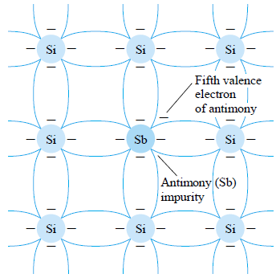
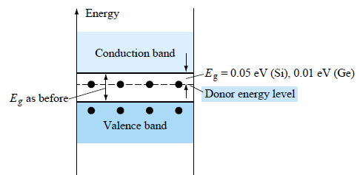
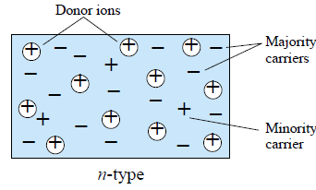
In this material, the electrons are called majority carrier and holes are called minority carrier

Slide 17
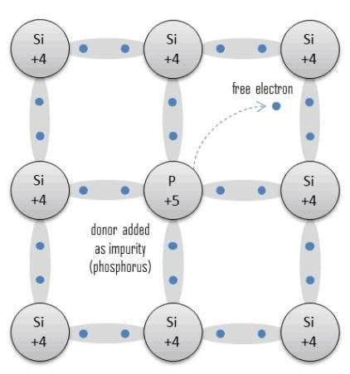
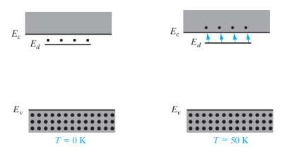
N-type extrinsic semiconductor

Slide 18
P-type Semiconductor
The P-type of material is obtained by adding the impurity of three valance electrons(tetravalent) such as boron, gallium, and indium.
In this combination, one electron is required to complete the covalent bonds of the newly formed lattice. The resulting vacancy is called hole which readily accept a free electron.
Atoms from group III (B, Al, Ga, and In) introduce impurity levels in Ge or Si near the valence band.
These levels are empty of electrons at 0 K.
At Low temp enough thermal energy is available to excite electrons from the valence band into the impurity level, leaving behind holes in the valence band.
Since this type of impurity level "accepts" electrons from the valence band, it is called an acceptor level, and the column III impurities are acceptor impurities in Ge and Si.

Slide 19
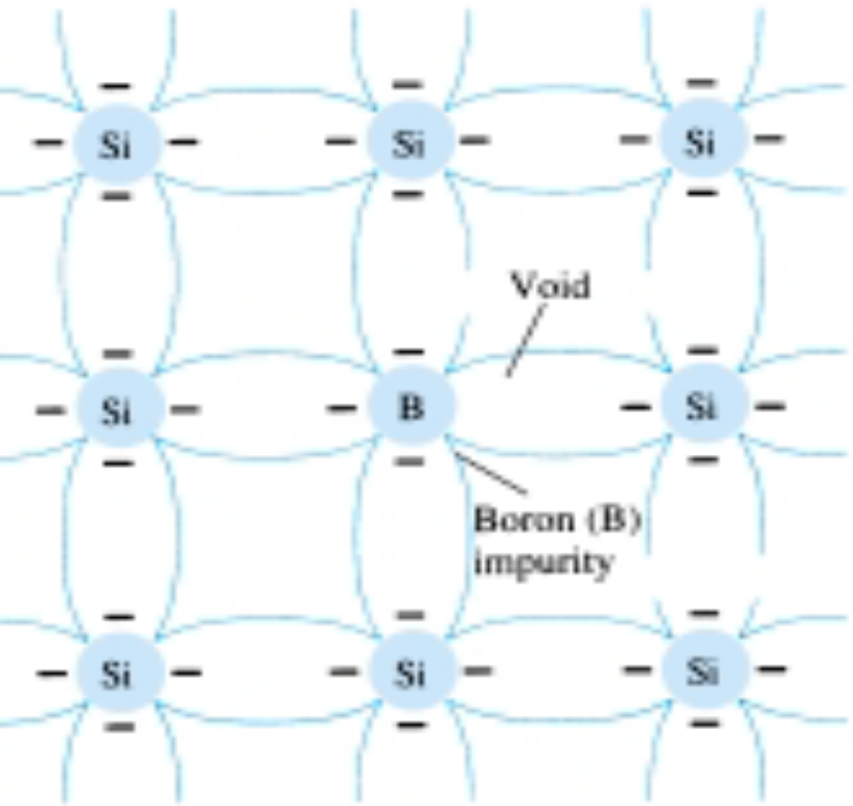
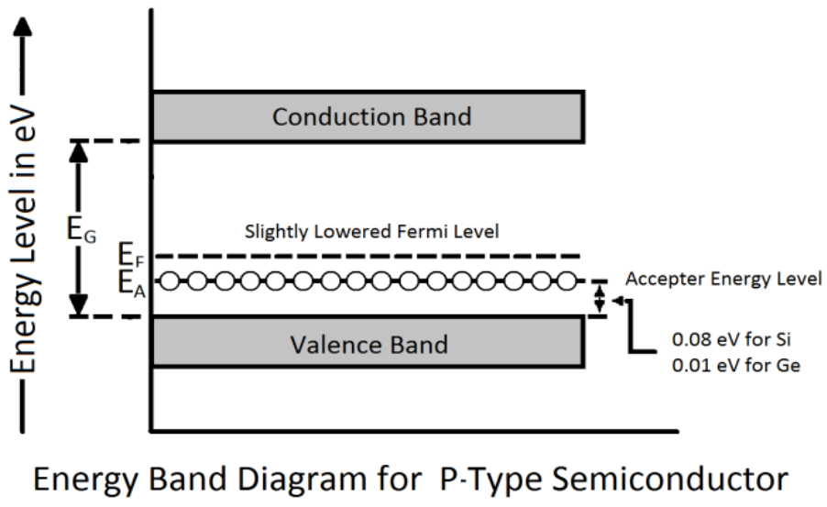
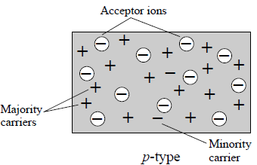
In this material, the holes are called majority carrier and electrons are called minority carrier

Slide 20
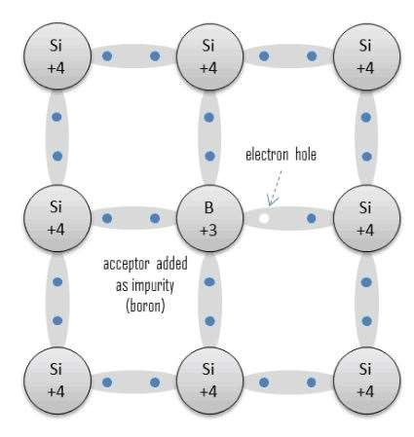
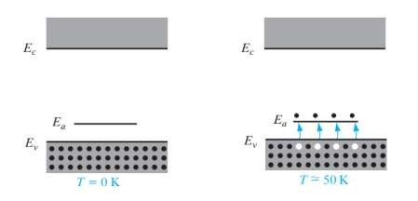
P-type extrinsic semiconductor

Slide 21
Introduction to Semiconductor Theory
In n-type material, the electron is the majority charge carrier and holes are minority.
In p-type material, the holes are the majority charge carrier and electrons are minority

Slide 22
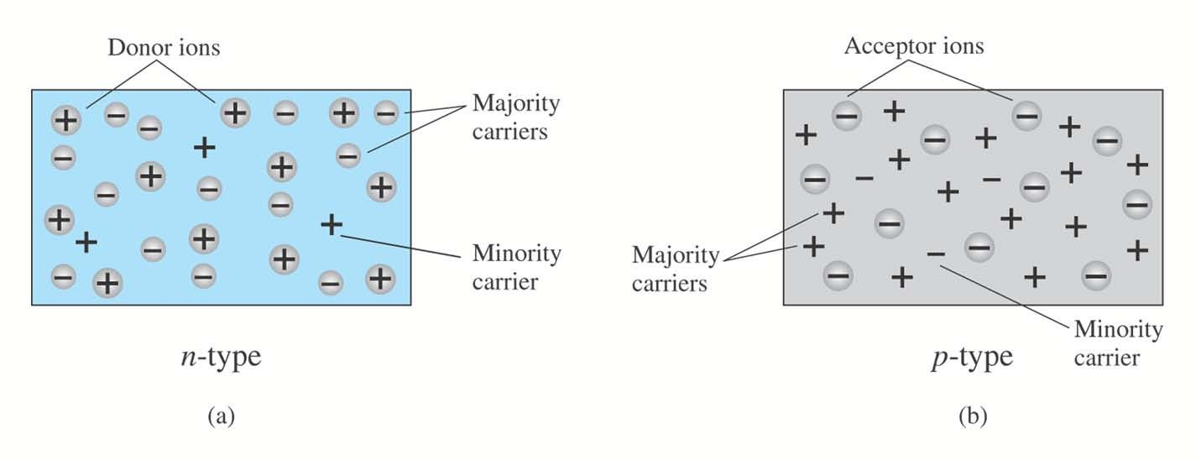
Majority and Minority carriers:
N-Type: electrons- Majority
holes-Minority
P-Type: holes- Majority
Electrons-Minority

Slide 23
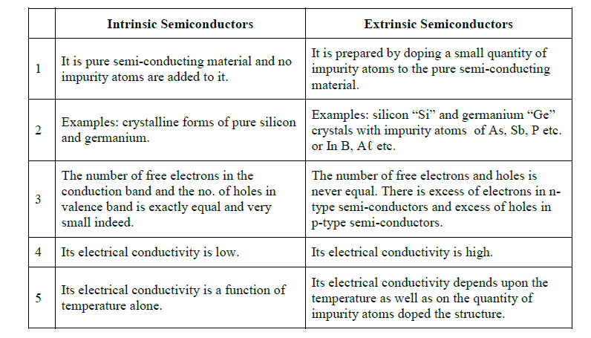
Difference between extrinsic and intrinsic semiconductor

